Slide 1
Basic Computing Curriculum
Session 6: Email for Communication
Notes:
Welcome to Session 3 of our course. In this presentation, we will cover the basics of Internet Navigation, including what is the internet, web browsers, searching for information online, and internet security and privacy.

Slide 2
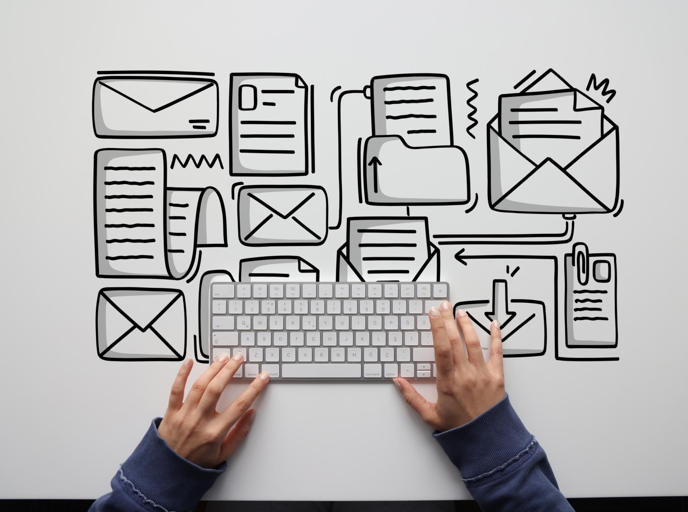
Presentation Overview
Understanding Email Communication
  Email communication is an essential tool for personal and professional communication. We will explore the history of email, the basics of email communication, and its importance in our daily lives.
Email Service Providers
  There are several email service providers available, each with its own unique features and benefits. We will explore the most popular email service providers and how to create an email account.
Sending, Receiving and Organizing Emails
  We will go through the steps involved in sending, receiving and organizing emails, including composing and formatting emails, managing email folders, and using email filters.
Attaching Files to Emails
  We will learn how to attach files to an email, including documents, images, and other files. We will also explore best practices for file attachments and how to troubleshoot common issues.
Notes:
We will start by understanding what email is and why it is important for communication. Then, we will explore the different email service providers available and how to create an email account. We will then go through the steps involved in sending, receiving and organizing emails. Finally, we will learn how to attach files to an email.

Slide 3

Introduction to Email
Instant Communication
  Email is an instant communication tool that enables you to send and receive messages in real-time, allowing for quick and efficient communication.
Cost Effective
  Email is a cost-effective communication tool as it eliminates the need for paper, postage, and other associated costs of traditional mail.
Easy to Use
  Email is easy to use and does not require any technical knowledge or expertise, making it accessible to anyone with an Internet connection.
Notes:
Email is a digital communication tool used to send and receive messages over the Internet. It is a fast and efficient way to communicate with people around the world. We will explore the various benefits of using email for communication.

Slide 4

What is Email?
  Email is a digital communication tool that allows users to send and receive messages over the internet. It is a fast and efficient way to communicate with people around the world.
Notes:
Email is a digital communication tool that allows you to send and receive messages over the Internet. It is a fast and efficient way to communicate with people around the world.

Slide 5
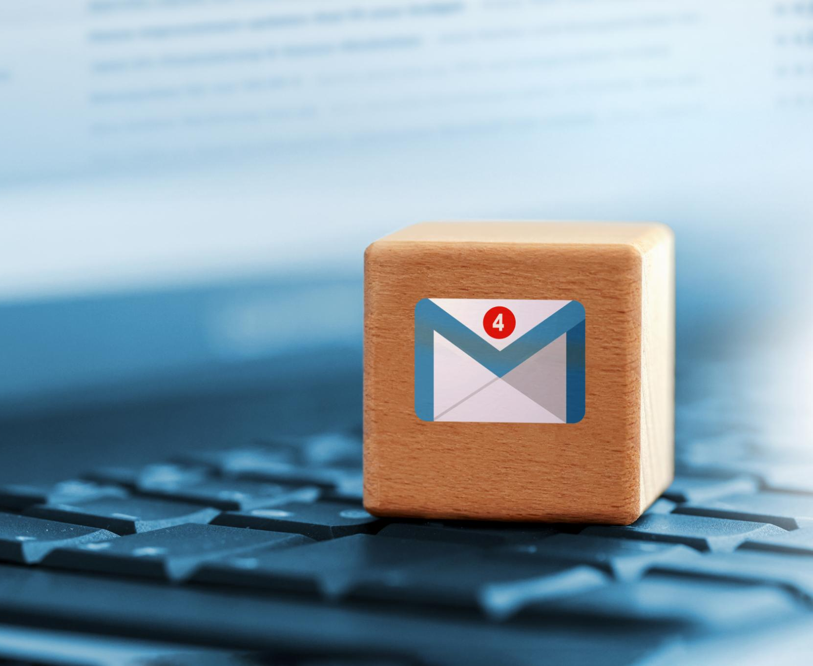
Why Use Email for Communication?
Convenient and Cost-effective
  Email is a convenient and cost-effective way to communicate with others. It allows you to send messages anytime, anywhere, without the need to wait for your recipient to be available.
Sending and Receiving Important Documents
  Email is useful for sending and receiving important documents and files. It provides a quick and efficient way to share information and collaborate on projects.
Notes:
Email is a convenient and cost-effective way to communicate with others. It allows you to send messages 24/7, without the need to wait for your recipient to be available. It is also useful for sending and receiving important documents and files.

Slide 6
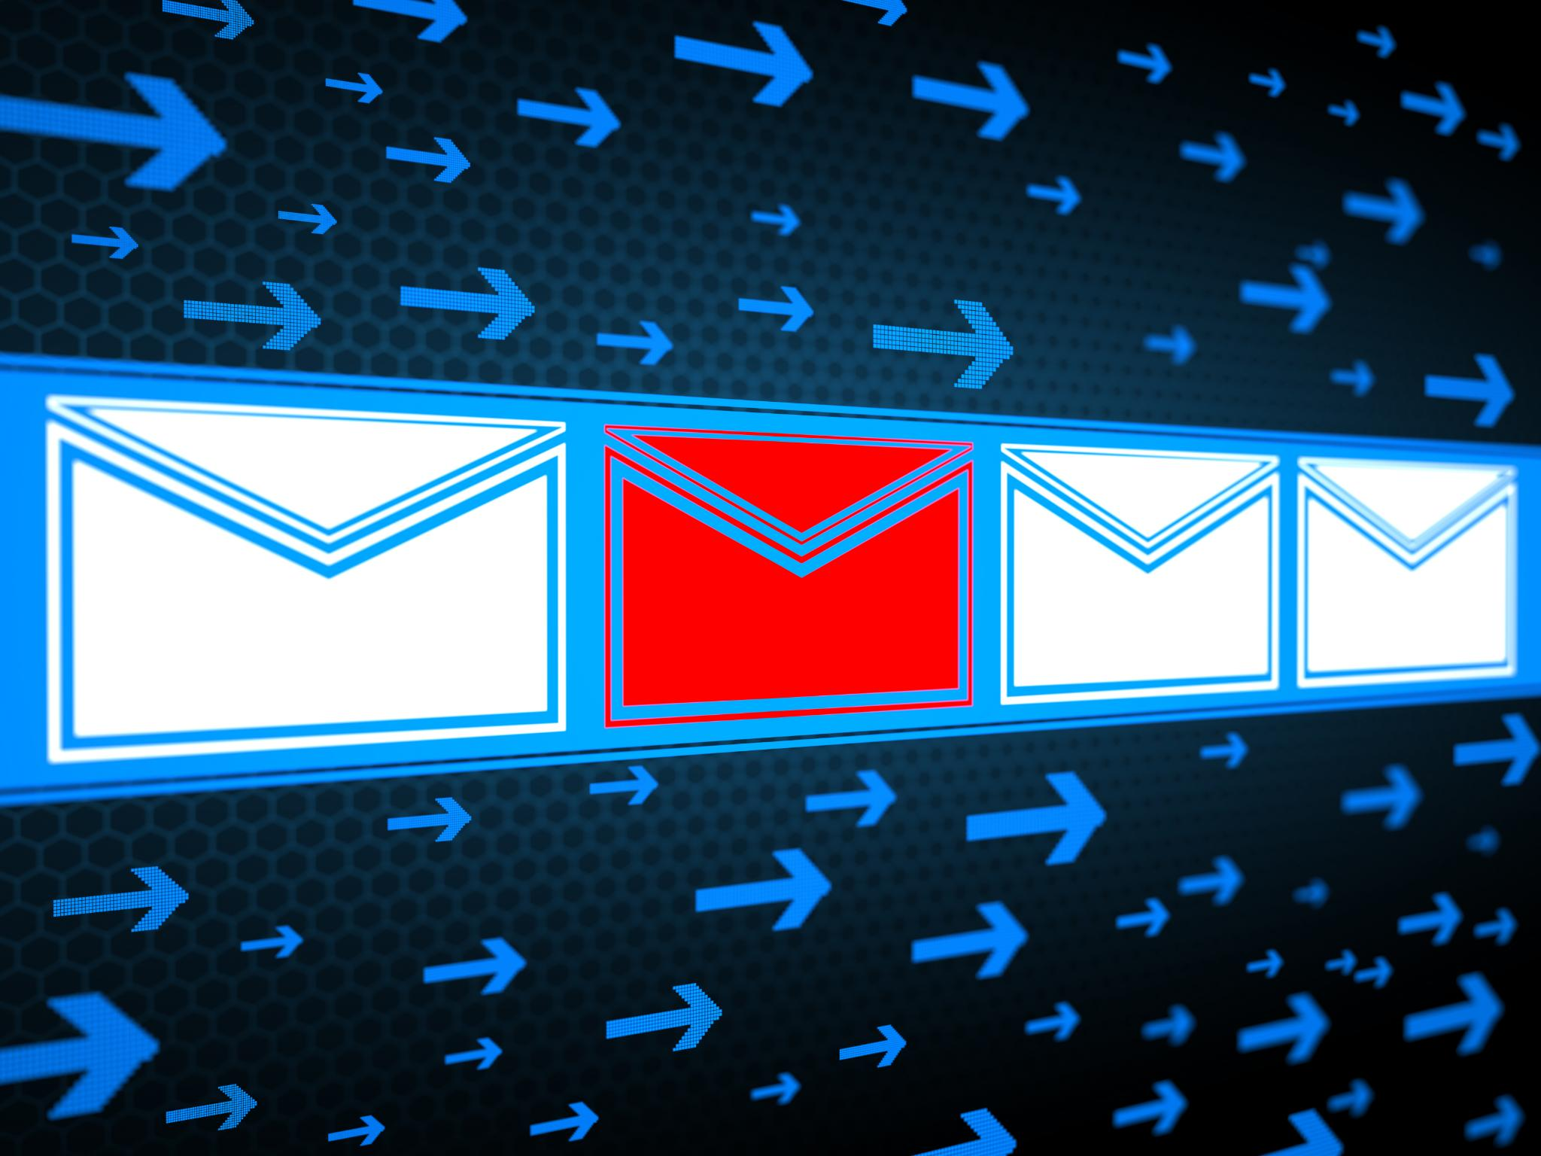
Email Service Providers
Gmail
  Gmail is a free email service provided by Google. It offers various features such as spam protection, custom themes, and integration with other Google services.
Outlook
  Outlook is an email service provided by Microsoft. It offers features such as calendar, contacts, and tasks management, and integration with other Microsoft services such as OneDrive and Skype.
Yahoo
  Yahoo Mail is a free email service provided by Yahoo. It offers features such as 1 TB of storage, spam protection, and integration with various Yahoo services.
Zoho
  Zoho Mail is an email service provided by Zoho. It offers features such as custom domains, spam protection, and integration with other Zoho services.
Notes:
There are different email service providers available that offer email services to users. We will explore some of the popular email service providers such as Gmail, Outlook, Yahoo, and Zoho.

Slide 7
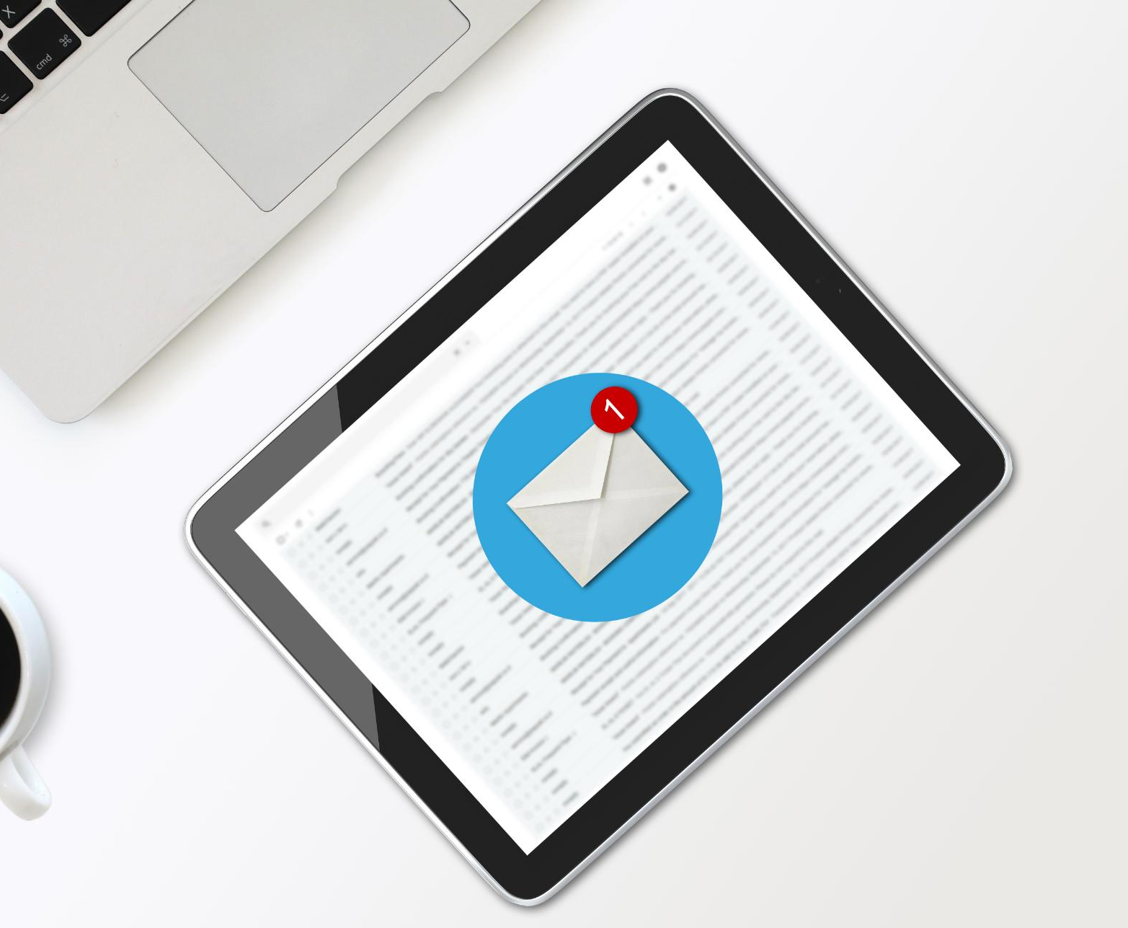
Gmail
Free Email Service
  Gmail is a popular free email service provided by Google that offers users a reliable and secure way to communicate with others.
Features
  Gmail offers several features such as a large storage capacity, spam filtering, smart replies, and integration with other Google products like Google Drive and Google Calendar.
Notes:
Gmail is a free email service provided by Google. It offers several features such as a large storage capacity, spam filtering, and integration with other Google products.

Slide 8

Outlook
Email Service
  Outlook is a free email service provided by Microsoft. It is a reliable and secure email service that offers several features such as a calendar, contacts, and tasks.
Calendar
  Outlook has a built-in calendar that allows you to schedule and manage appointments, meetings, and events. You can also set up reminders and receive notifications for upcoming events.
Contacts
  Outlook allows you to manage your contacts and keep track of important information such as phone numbers, email addresses, and business details. You can also set up distribution lists and send email to multiple contacts at once.
Integration with Other Microsoft Products
  Outlook offers seamless integration with other Microsoft products such as OneDrive, Skype, and Office. This makes it easy to share files, collaborate with others, and manage your work more efficiently.
Notes:
Outlook is a free email service provided by Microsoft. It offers several features such as a calendar, contacts, and tasks. It also offers integration with other Microsoft products.

Slide 9
Yahoo
  Yahoo is a free email service that offers several features such as a large storage capacity, spam filtering, and integration with other Yahoo! products.
Notes:
Yahoo is a free email service provided by Yahoo!. It offers several features such as a large storage capacity, spam filtering, and integration with other Yahoo! products.

Slide 10
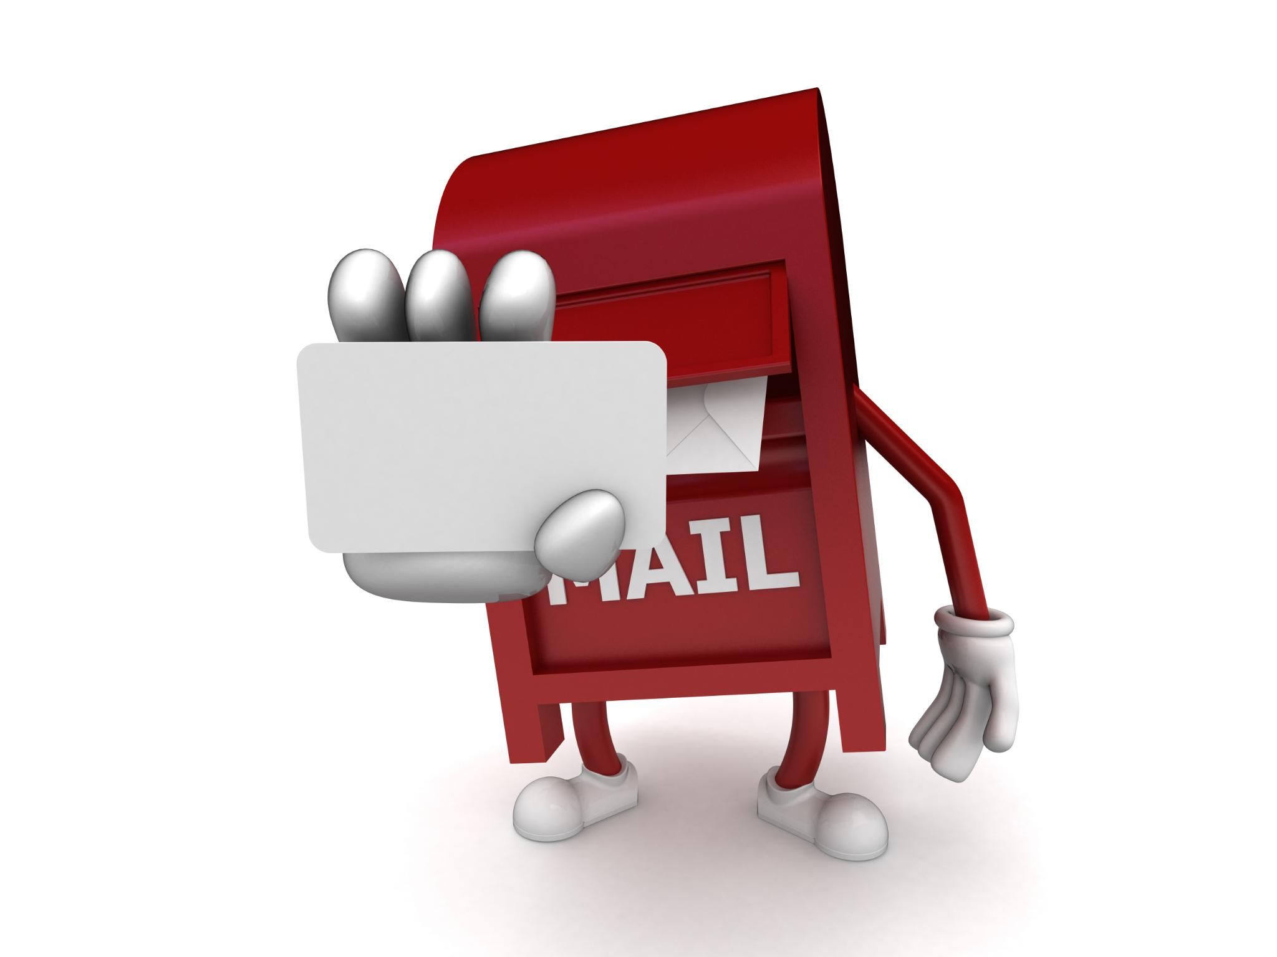
Zoho
  Zoho is a free email service offered by Zoho Corporation that provides several features such as a calendar, contacts, and tasks. It also offers integration with other Zoho products, making it a popular choice for businesses.
Notes:
Zoho is a free email service provided by Zoho Corporation. It offers several features such as a calendar, contacts, and tasks. It also offers integration with other Zoho products.

Slide 11

Creating an Email Account
Choosing Email Address
  Choosing an email address is the first step in creating an email account. It should be unique and memorable, so people can easily remember and use it to communicate with you.
Password Strength
  Password strength is important to keep your email account secure. A strong password should contain a mix of letters, numbers, and special characters.
Email Verification
  Email verification is the final step in creating an email account. It confirms that the email address belongs to you and ensures that only you have access to your account.
Notes:
To use email for communication, it is necessary to have an email account. We will go through the different steps involved in creating an email account such as choosing an email address, password strength, and email verification.

Slide 12

Steps to Create an Email Account
Personal Information
  To create an email account, you need to provide personal information such as your name, date of birth, and phone number. This step is necessary to verify your identity and protect your privacy.
Email Address
  Choose an email address that is easy to remember and professional. It should also be unique and not already taken by another user.
Strong Password
  Create a strong password that is easy to remember but difficult to guess. Use a combination of uppercase and lowercase letters, numbers, and symbols.
Notes:
The steps to create an email account vary depending on the email service provider. However, the basic steps involve providing personal information such as name, date of birth, and phone number. You will also need to choose an email address and a strong password.

Slide 13

Choosing an Email Address
  Choosing the right email address is important as it is often the first point of contact with others, whether for personal or business purposes. A good email address can convey professionalism and reliability, while a bad one can have the opposite effect.
Notes:
Choosing an email address is an important part of creating an email account. It is recommended to use an email address that is easy to remember and professional. Avoid using email addresses that are too personal or inappropriate.

Slide 14

Password Strength
  Creating a strong password is important to protect your email account from unauthorized access. A strong password should be a combination of uppercase and lowercase letters, numbers, and special characters. It should not include common words or personal information such as your name or birthdate.
Notes:
A strong password is essential to secure your email account. It is recommended to use a combination of uppercase and lowercase letters, numbers, and special characters. Avoid using common words or personal information.

Slide 15

Email Verification
  After creating an email account, you will need to verify your email address by clicking on the verification link in the email sent by the email service provider.
Notes:
After creating an email account, most email service providers will require you to verify your email address. This is done by sending a verification email to your email address. You will need to click on the verification link in the email to complete the verification process.

Slide 16

Sending, Receiving, and Organizing Emails
Sending Emails
  Before sending an email, you need to create a new message, add a recipient, and write the subject and message body. Once everything is ready, you can click on the send button to send the email.
Receiving Emails
  When someone sends you an email, it will appear in your inbox. You can read the email, reply to it, or forward it to someone else.
Organizing Emails
  You can organize your emails by creating folders, labels, or categories. This way, you can keep your inbox clutter-free and find important emails easily.
Notes:
Once you have created an email account, you can start sending and receiving emails. We will go through the different steps involved in sending, receiving, and organizing emails.

Slide 17
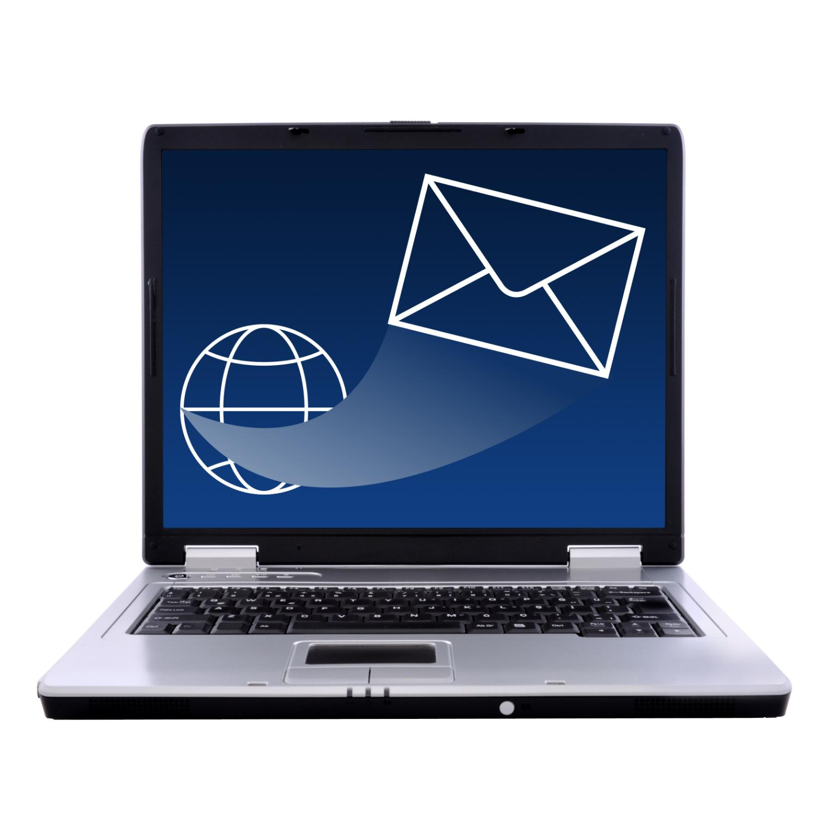
Sending an Email
Compose a new email
  To send an email, you will need to open your email client and compose a new email.
Enter the Recipient's Email Address
  To send an email, you will need to enter the recipient's email address in the 'To' field.
Add a Subject
  To ensure that the recipient knows what the email is about, you should add a clear and concise subject line to the email.
Write the Message
  To send an email, you will need to write the message in the body of the email. Make sure that the message is clear and concise.
Add Attachments
  You can also attach files, images, or documents to the email by clicking on the 'Attach' button.
Notes:
To send an email, you will need to compose a new email, enter the recipient's email address, add a subject, and write the message. You can also add attachments to the email.

Slide 18
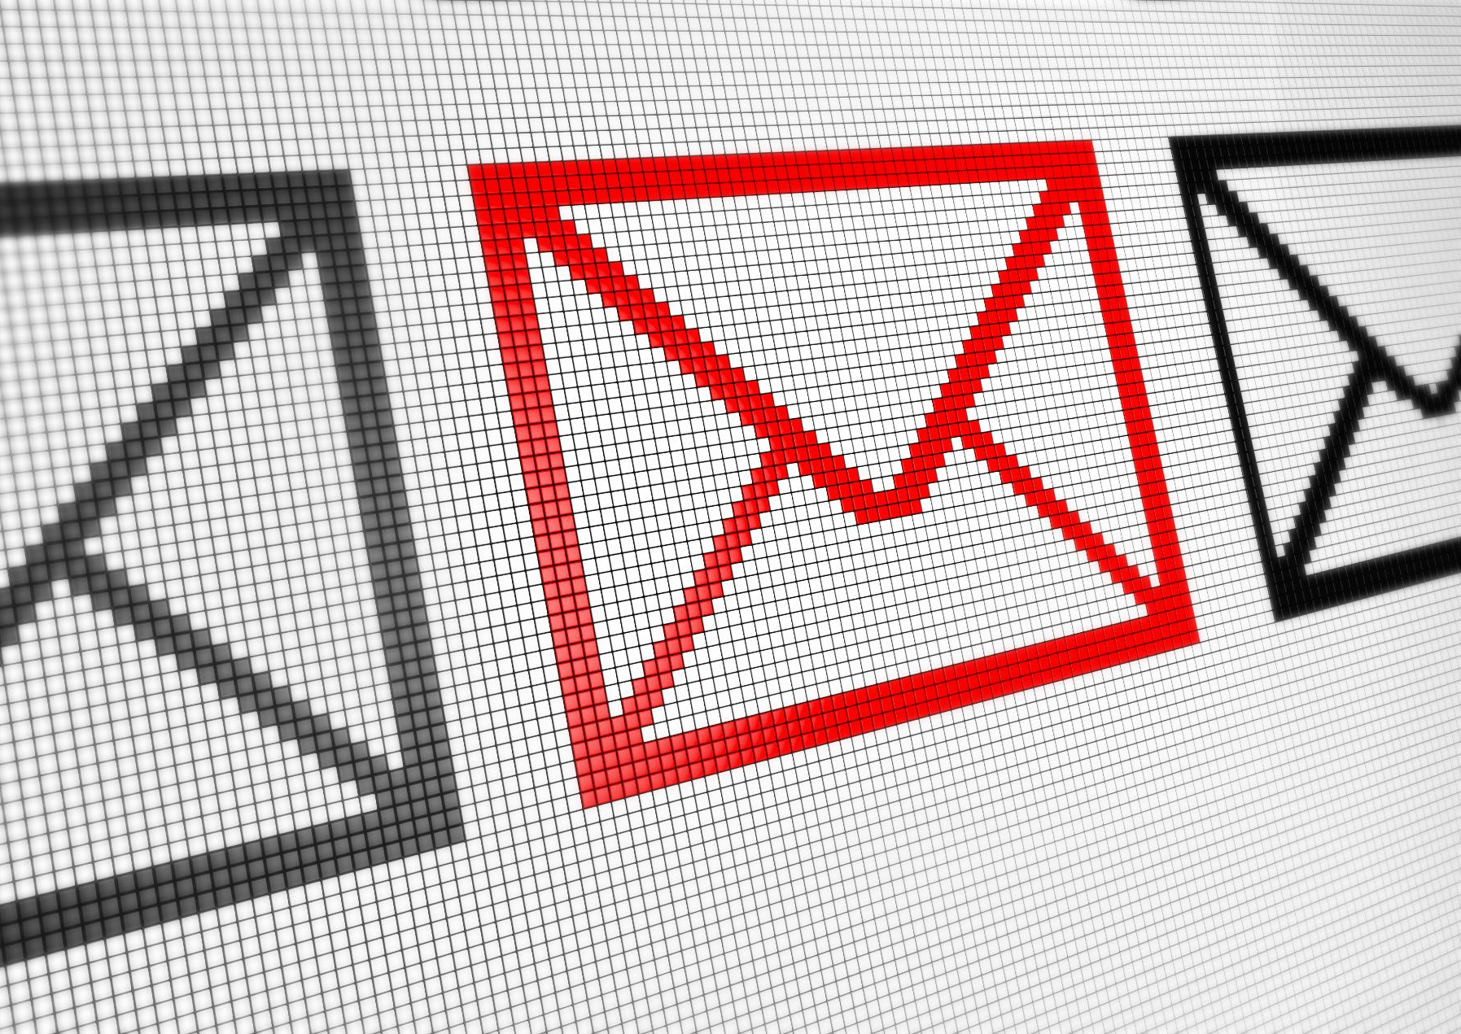
Replying to an Email
  Replying to an email is easy. Simply click on the reply button in the email, and a new email window will open with the original message already included. You can then type your reply and send it.
Notes:
To reply to an email, you can click on the reply button in the email. This will open a new email window with the original email already included. You can then compose your reply and send it.

Slide 19
Forwarding an Email
  To forward an email, open the email and click on the forward button to open a new email window with the original email already included. Then add the email address of the recipient and send it.
Notes:
To forward an email, you need to open the email and click on the forward button. This will open a new email window with the original email already included. You can then add the email address of the recipient and send it.

Slide 20
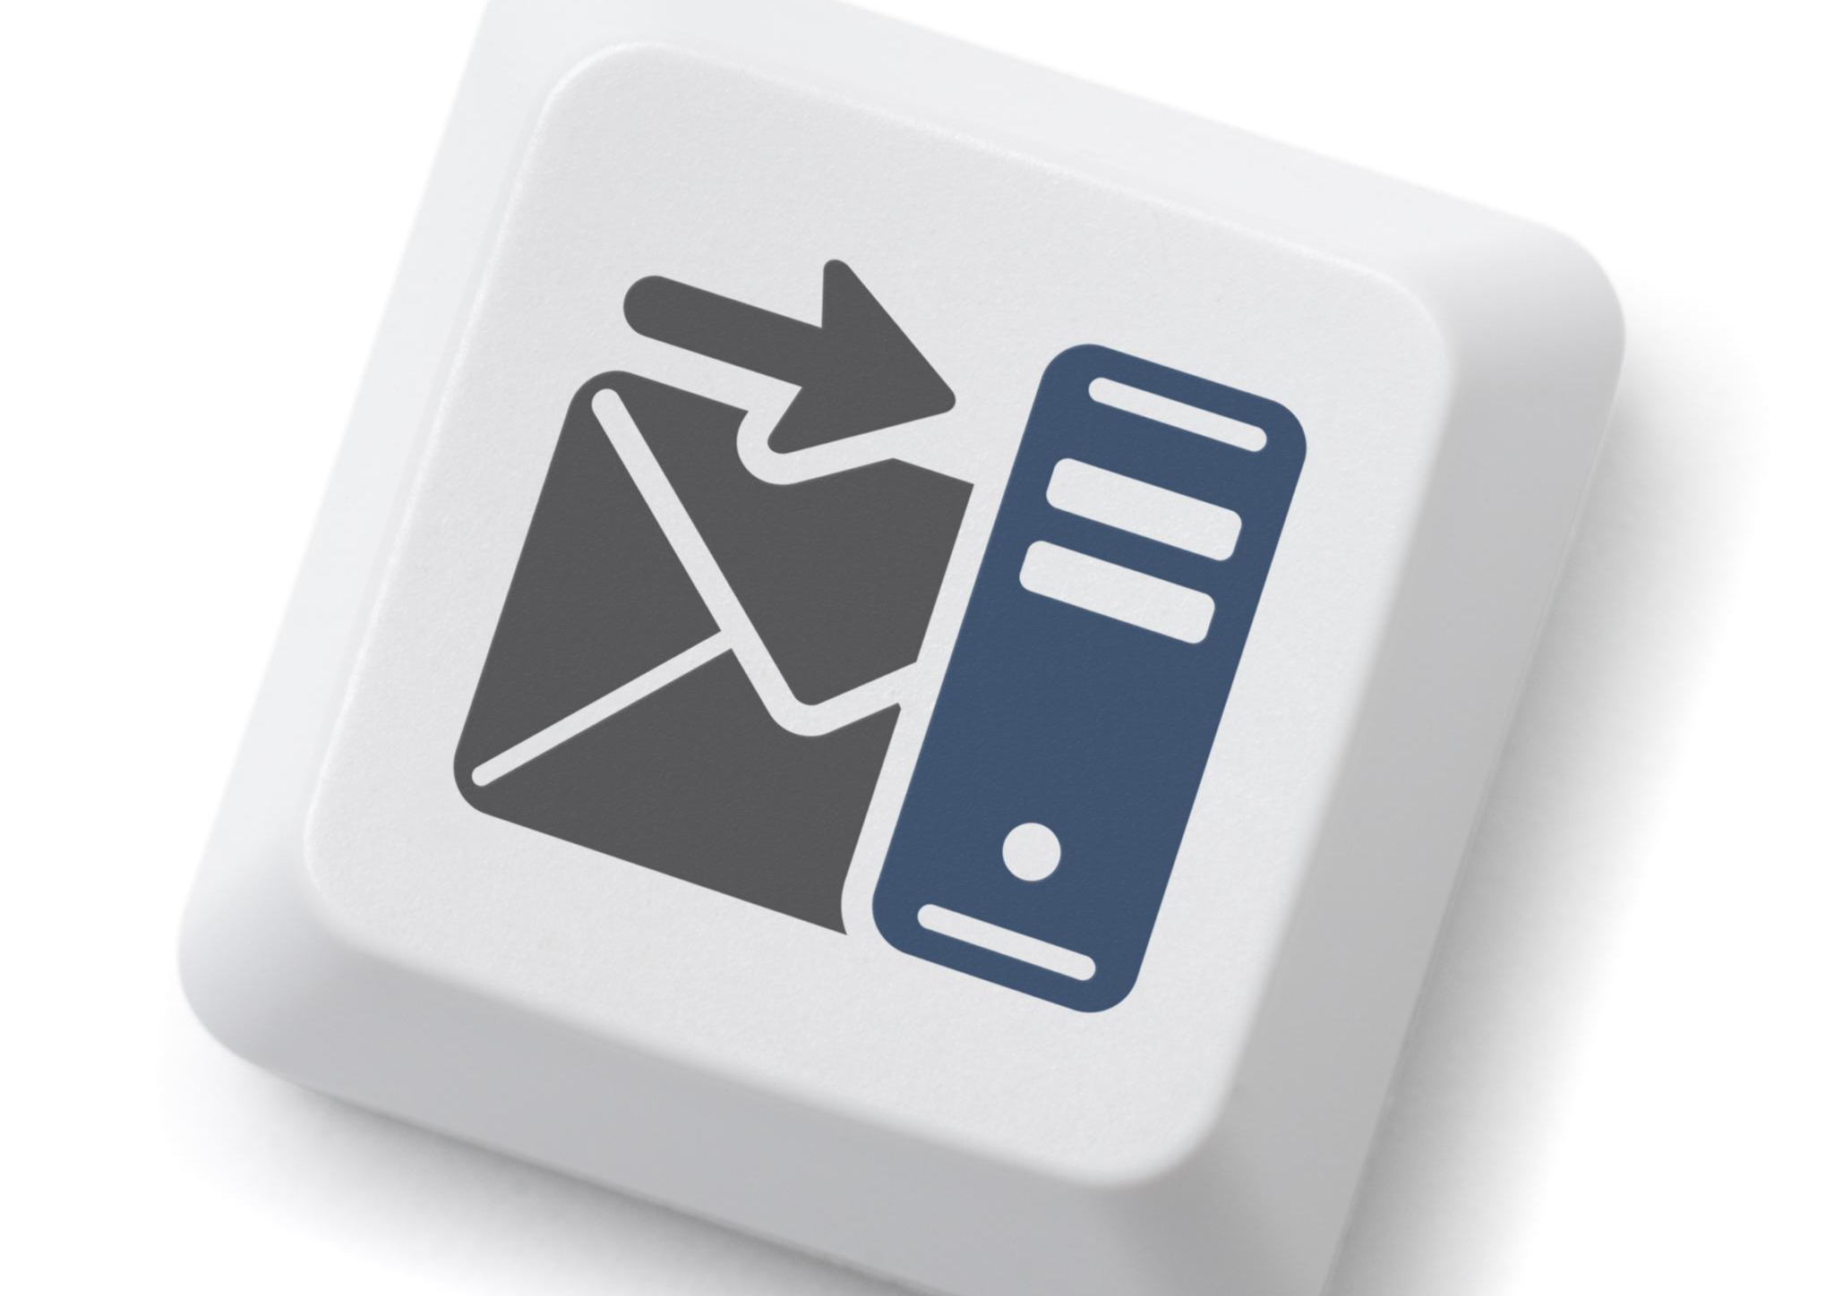
Organizing Emails in Folders
  Organizing emails in folders can help you manage your emails efficiently. You can create folders and move emails to specific folders. This can help you keep track of important emails and reduce clutter.
Notes:
Organizing emails in folders can help you manage your emails efficiently. Most email service providers allow you to create folders and move emails to specific folders. This can help you keep track of important emails and reduce clutter.

Slide 21
Attaching Files to an Email
  Attaching files to an email can be done by clicking on the attachment button and selecting the file. It is important to note that there is a size limit to attachments.
Notes:
You can attach files to an email by clicking on the attachment button in the email. You can then select the file you want to attach and add it to the email. It is important to note that there is a size limit to the attachment.

Slide 22
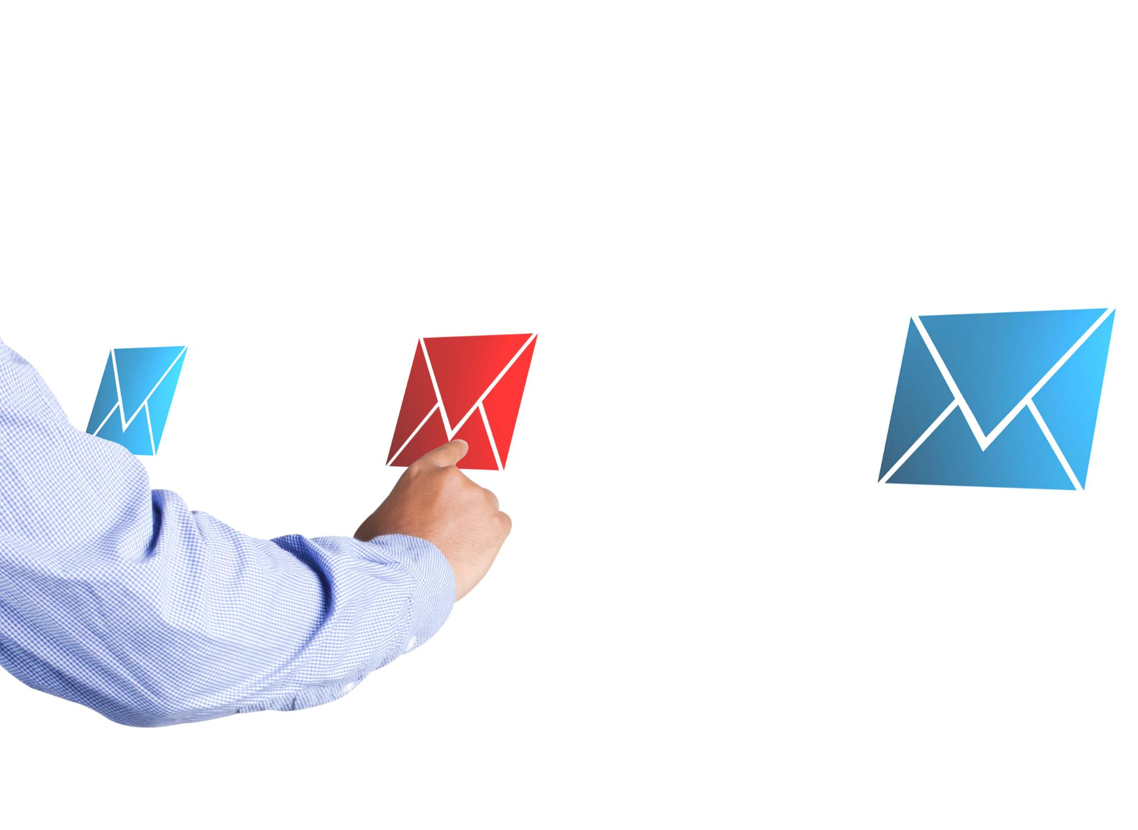
Types of Files that can be Attached to an Email
Document Files
  Document files can be attached to an email, including Microsoft Word, Excel, and PowerPoint documents, as well as PDF files.
Photo and Image Files
  Photo and image files can be attached to an email, including JPEG, TIFF, and PNG files.
Video Files
  Video files can be attached to an email, including MP4,AVI, and WMV files.
Restrictions on File Types
  It is important to note that some email service providers may have restrictions on the types of files that can be attached.
Notes:
Most file types can be attached to an email such as documents, photos, and videos. However, it is important to note that some email service providers may have restrictions on the types of files that can be attached.

Slide 23
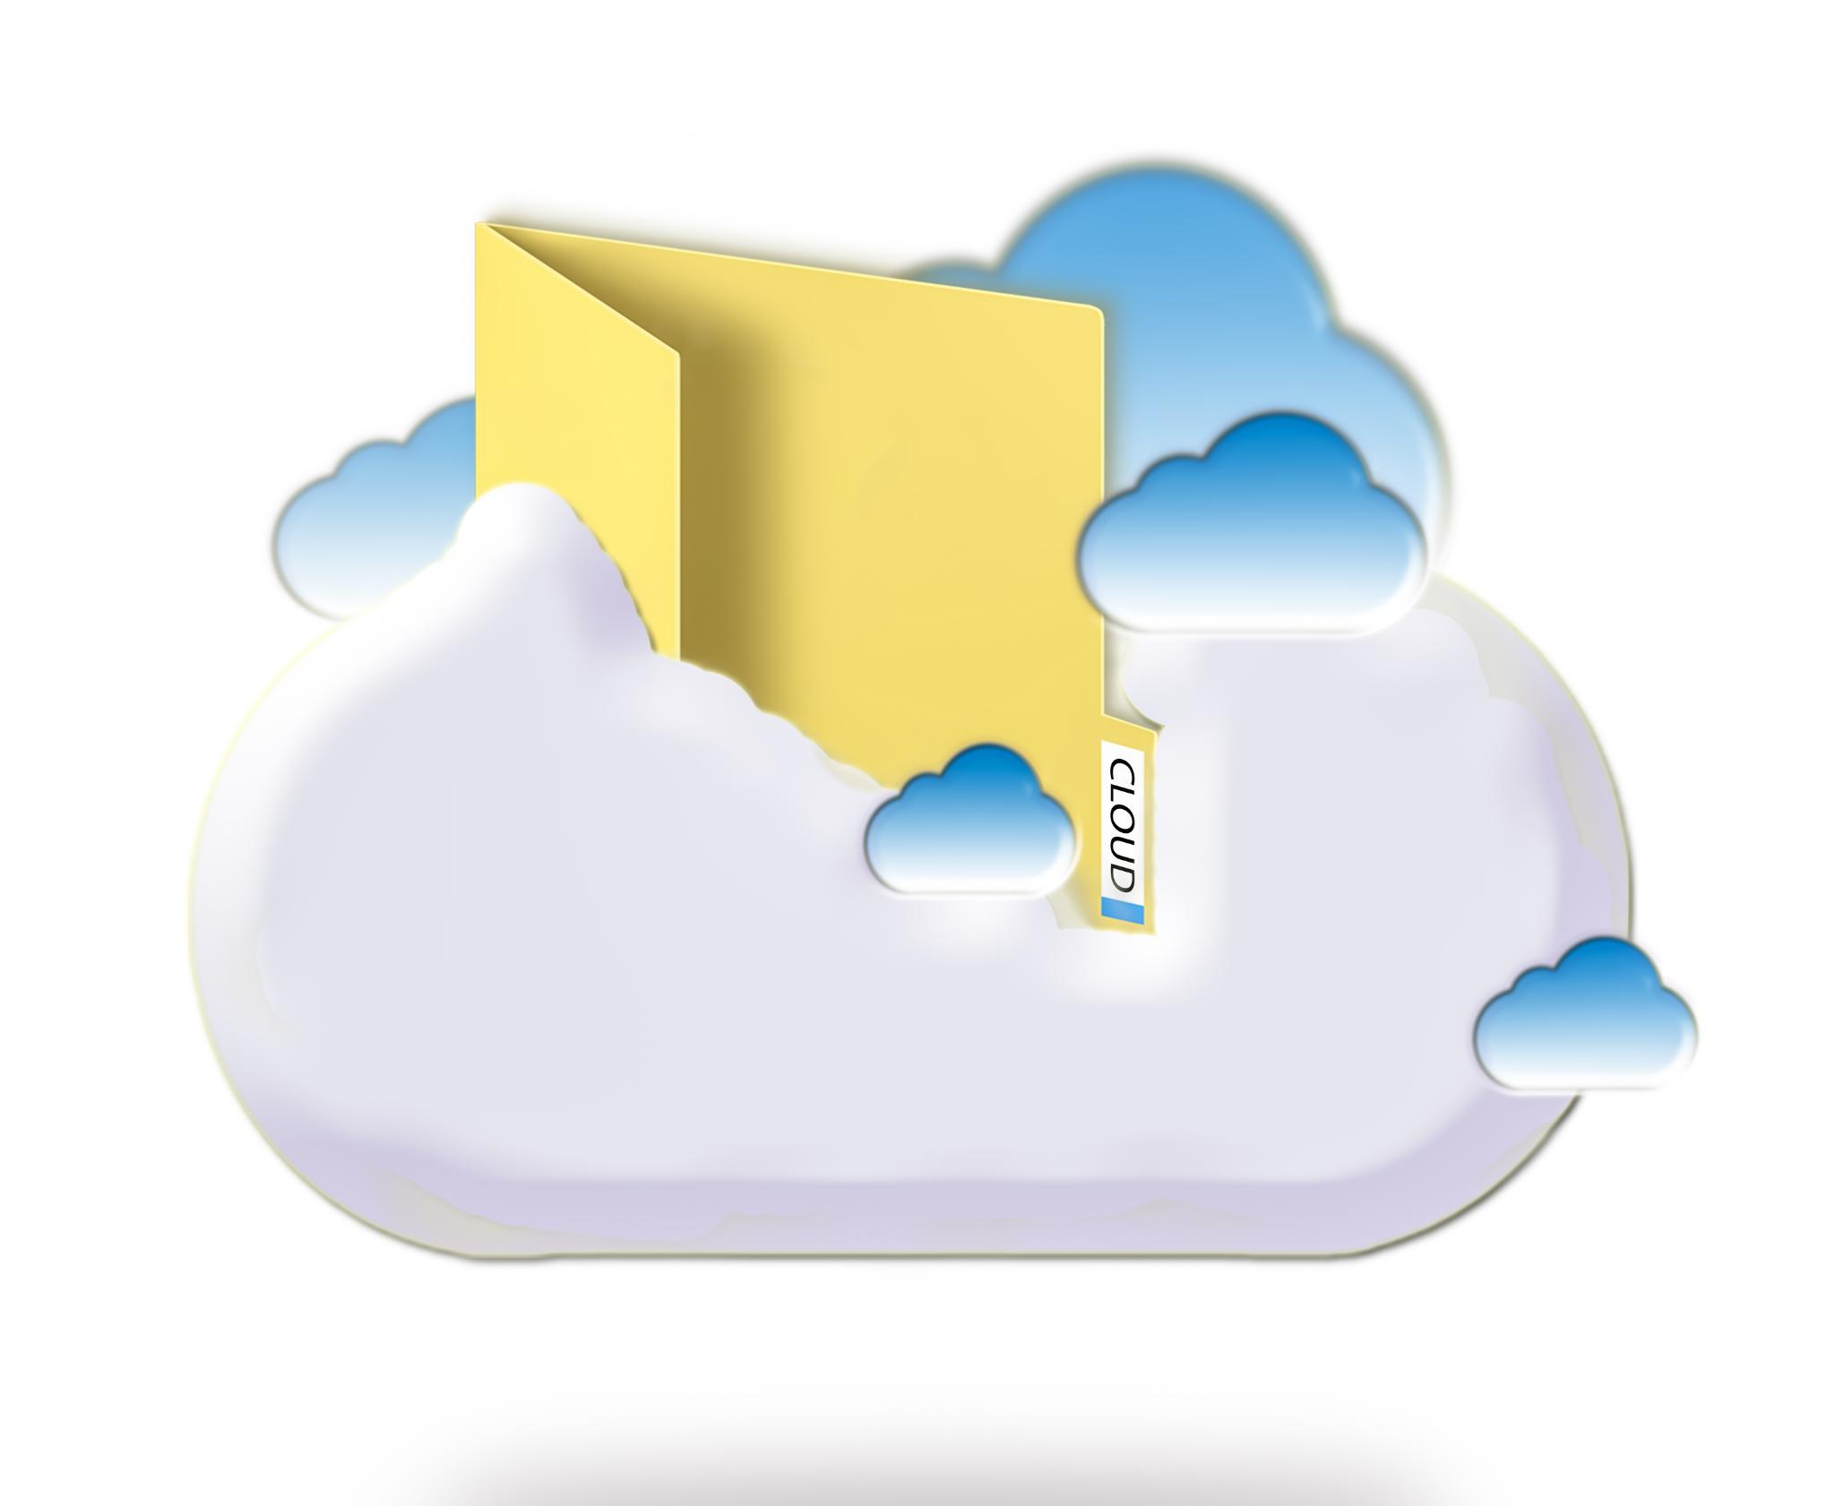
Attachment Size Limit
Email Attachment Size Limit
  Most email service providers have a size limit on the attachments that can be added to an email. It is important to check the size limit before attaching a file to an email.
Cloud Storage Services
  If the file is too large to attach to an email, it can be shared using a cloud storage service such as Google Drive or Dropbox.
Notes:
Most email service providers have a size limit on the attachments that can be added to an email. It is important to check the size limit before attaching a file. If the file is too large, it can be shared using a cloud storage service such as Google Drive or Dropbox.

Slide 24
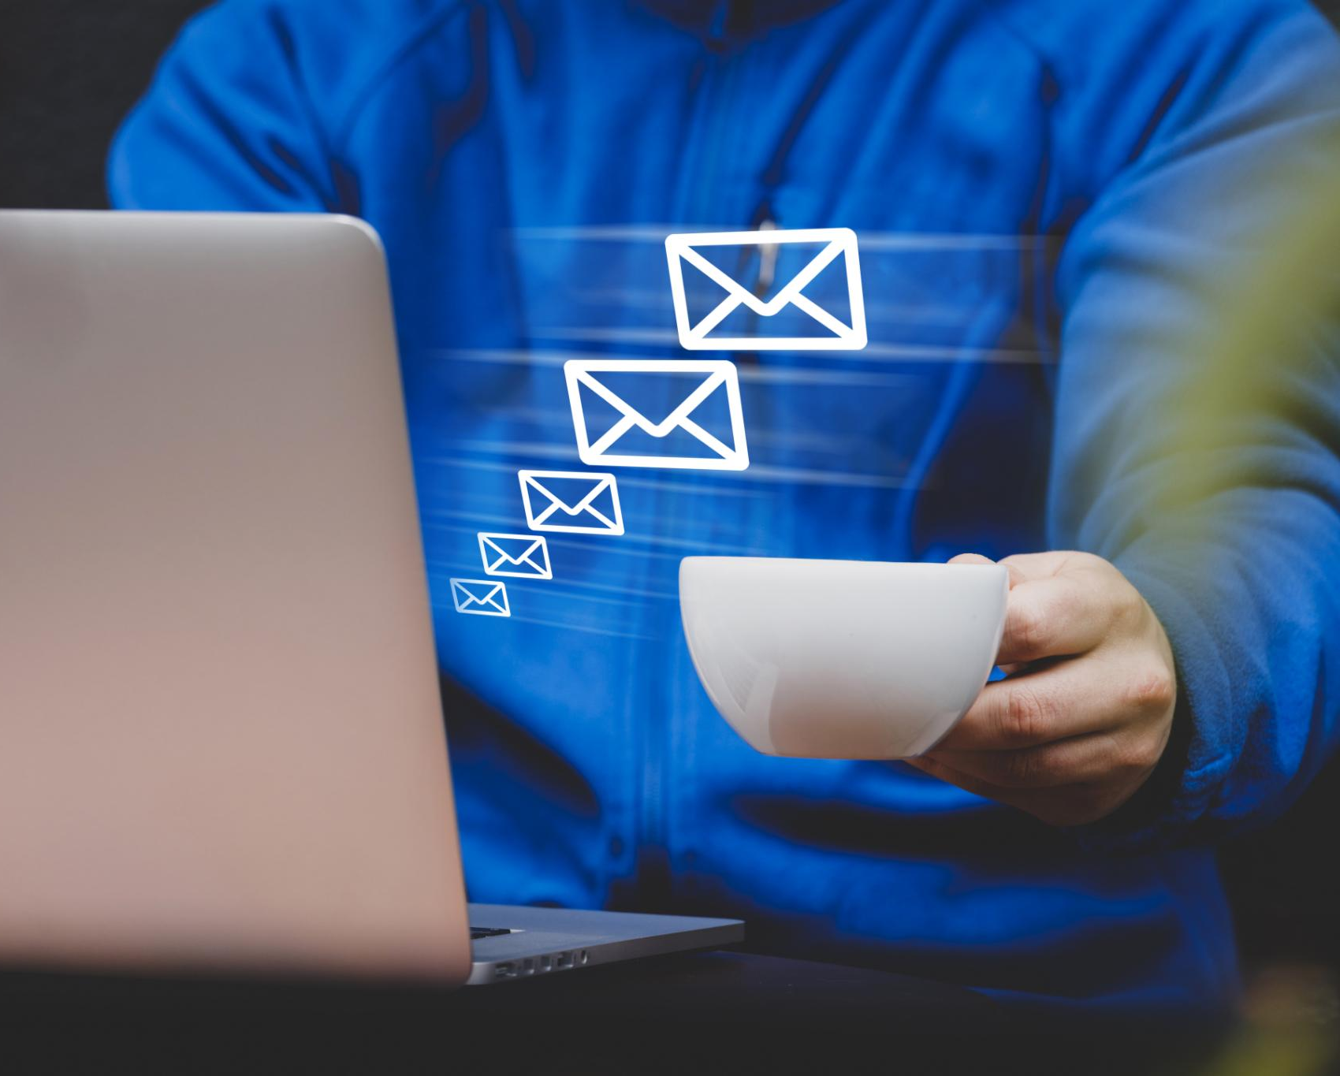
Practical Activity
Creating an Email Account
  Learn how to create an email account by following step-by-step instructions provided on the screen. It is an essential tool for personal and professional communication, and it is easy to set up.
Sending and Receiving Emails
  Once you have created an email account, learn how to send and receive emails by following step-by-step instructions provided on the screen. It is an essential tool for personal and professional communication, and it is easy to use.
Notes:
Let's create an email account, send, and receive emails. Follow the instructions on the screen to create an email account. Once you have created an email account, send an email to the provided email address and check your inbox for a reply.

